Slide 1
INF10025
Data Management and Analytics
Week 02 – Part 2
Queries with Totals

Slide 2

Totals
Often, when users want to retrieve data from database tables,
they want to display some totals
How many employees do we have?
How many students are enrolled in INF10025?
How many staff of each gender do we have?
In the database world, this is often referred to as Aggregation
Typical total (or aggregation) functions are Count, Sum, Min, Max, Average

Slide 3

Count Values
Requirement: Count how many movies belong to each rating code
The answer should be in this format
  G 24
  PG 45
  M 121
  MA 83
  R 5
This query must display the Rating Code in column 1
This query must display the Count value in column 2

Slide 4
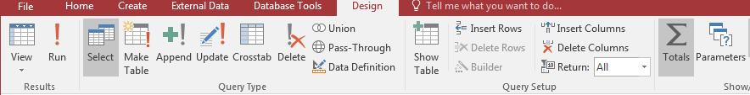
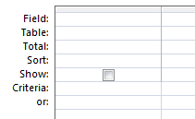

Totals
In Query Design Ribbon, click on the Totals icon
This adds a Total row to the
Query Design Grid

Slide 5
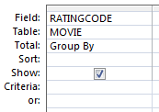

Totals
Add the field RatingCode to the Design Grid.
The Total operation says Group By.
This means that all of the RatingCodes in the
records will be Grouped.
G is a group
PG is a group
MA is a group…

Slide 6
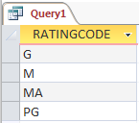
Totals
If we ran this query as it is, then we simply have a list of RatingCodes
that appear in the Movie table.
Not really useful.

Slide 7
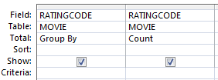
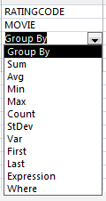
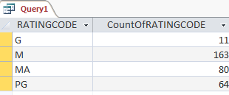

Totals
Add the field RatingCode for a second time
to the Design Grid.
This time change the type of Total
(or aggregation) you want to perform
In this example,
we will select
Count from the
pull down menu
Running the query
shows the count value
for each ratingcode.

Slide 8
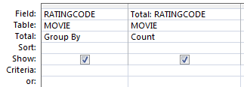
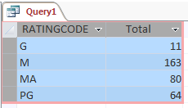
Changing the column heading
The column heading
CountOfRATINGCODE is not very
professional
Add a new column heading by placing
the new heading followed by a semi
colon : character prefix in front of the
field name
E.g. Total: RATINGCODE
Note: This technique applies to any column
heading in any query that you create

Slide 9
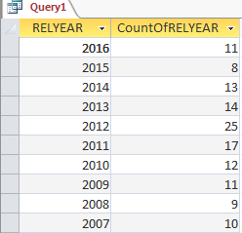
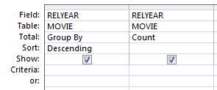

Another example of Group By
This is a similar example.
In this case, the query groups records by relyear.
For each relyear value, the total number of records
is counted.

Slide 10
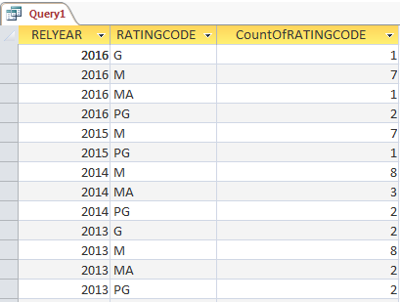
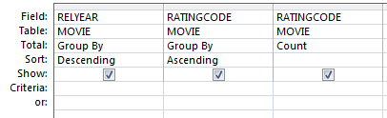
Two columns with Group By
Requirement: Count the number of movies in
each rating code for each release year.
The 1st column groups data by Relyear
The 2nd column groups data by RatingCode
within a Relyear
The 3rd column shows the count of movies for
each group combination.
2016 has 11 movies
Of those:
  7 have an M rating
  2 have a PG rating
  1 has a G rating
  1 has a MA rating

Slide 11
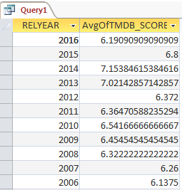
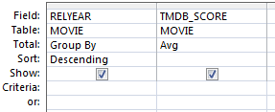
Two columns with Group By
This example demonstrates the AVG aggregation
function.
The average TMDB score is calculated for each year.

Slide 12
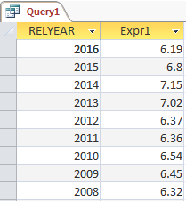
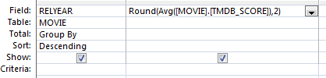


Two columns with Group By
The round the AVG calculation, we can use
the Round() function
Round() requires
the value that you want to round
the number of decimal places required
Write the expression in the Field cell:

Slide 13
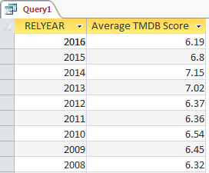

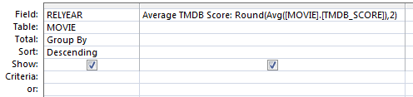
Two columns with Group By
Access automatically adds the column name prefix Expr1.
You can replace this prefix with any heading that you want

Slide 14
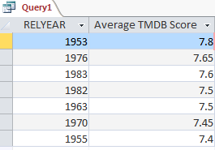
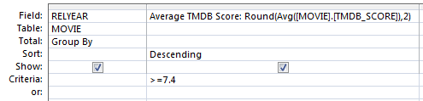
Two columns with Group By
With any of the aggregate functions you can
include a criteria that is applied to the totals
generated by the aggregate functions.
In this case, the query will only show totals where
the average TMDB score is greater than or
equal to 7.4

